Slide 2
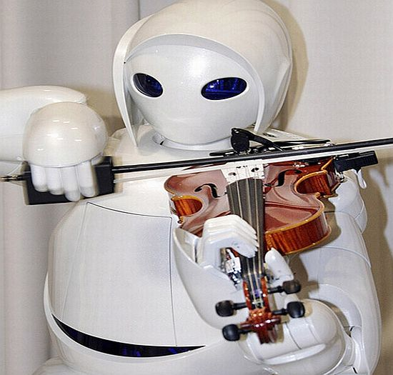
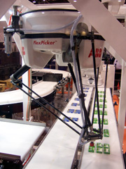
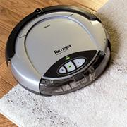
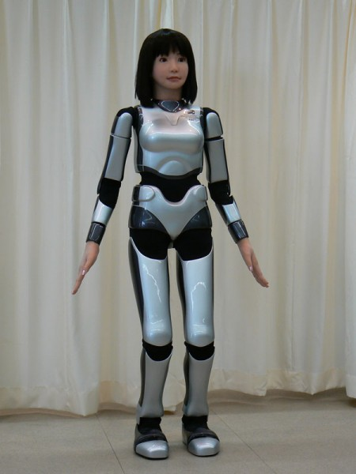
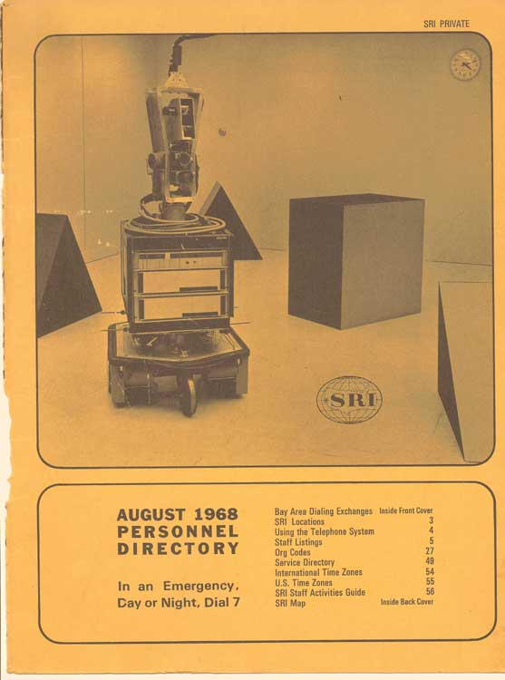
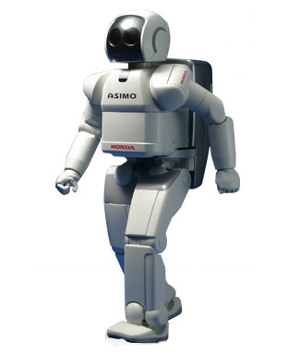
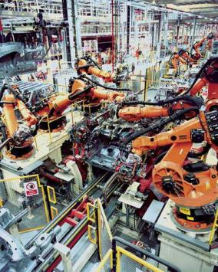
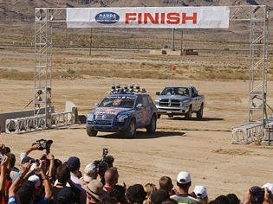
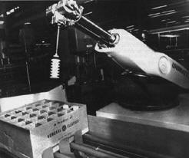
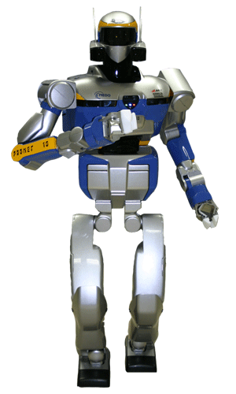
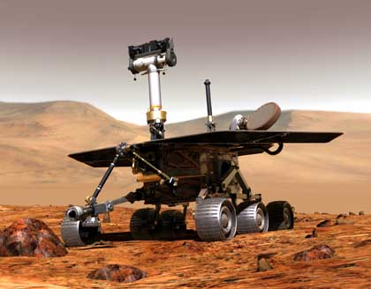
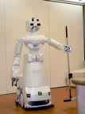
1960 1970 1980 1990 2000 2010
T. Lozano-Perez, 1983
« Spatial Planning: a Configuration Space Approach »
50 years of Robotics
40 years of Planning
30 years of Motion Planning
Fikes, Nilsson, 1971
« STRIPS: A new approach to the application of theorem proving to problem solving »,

Slide 3
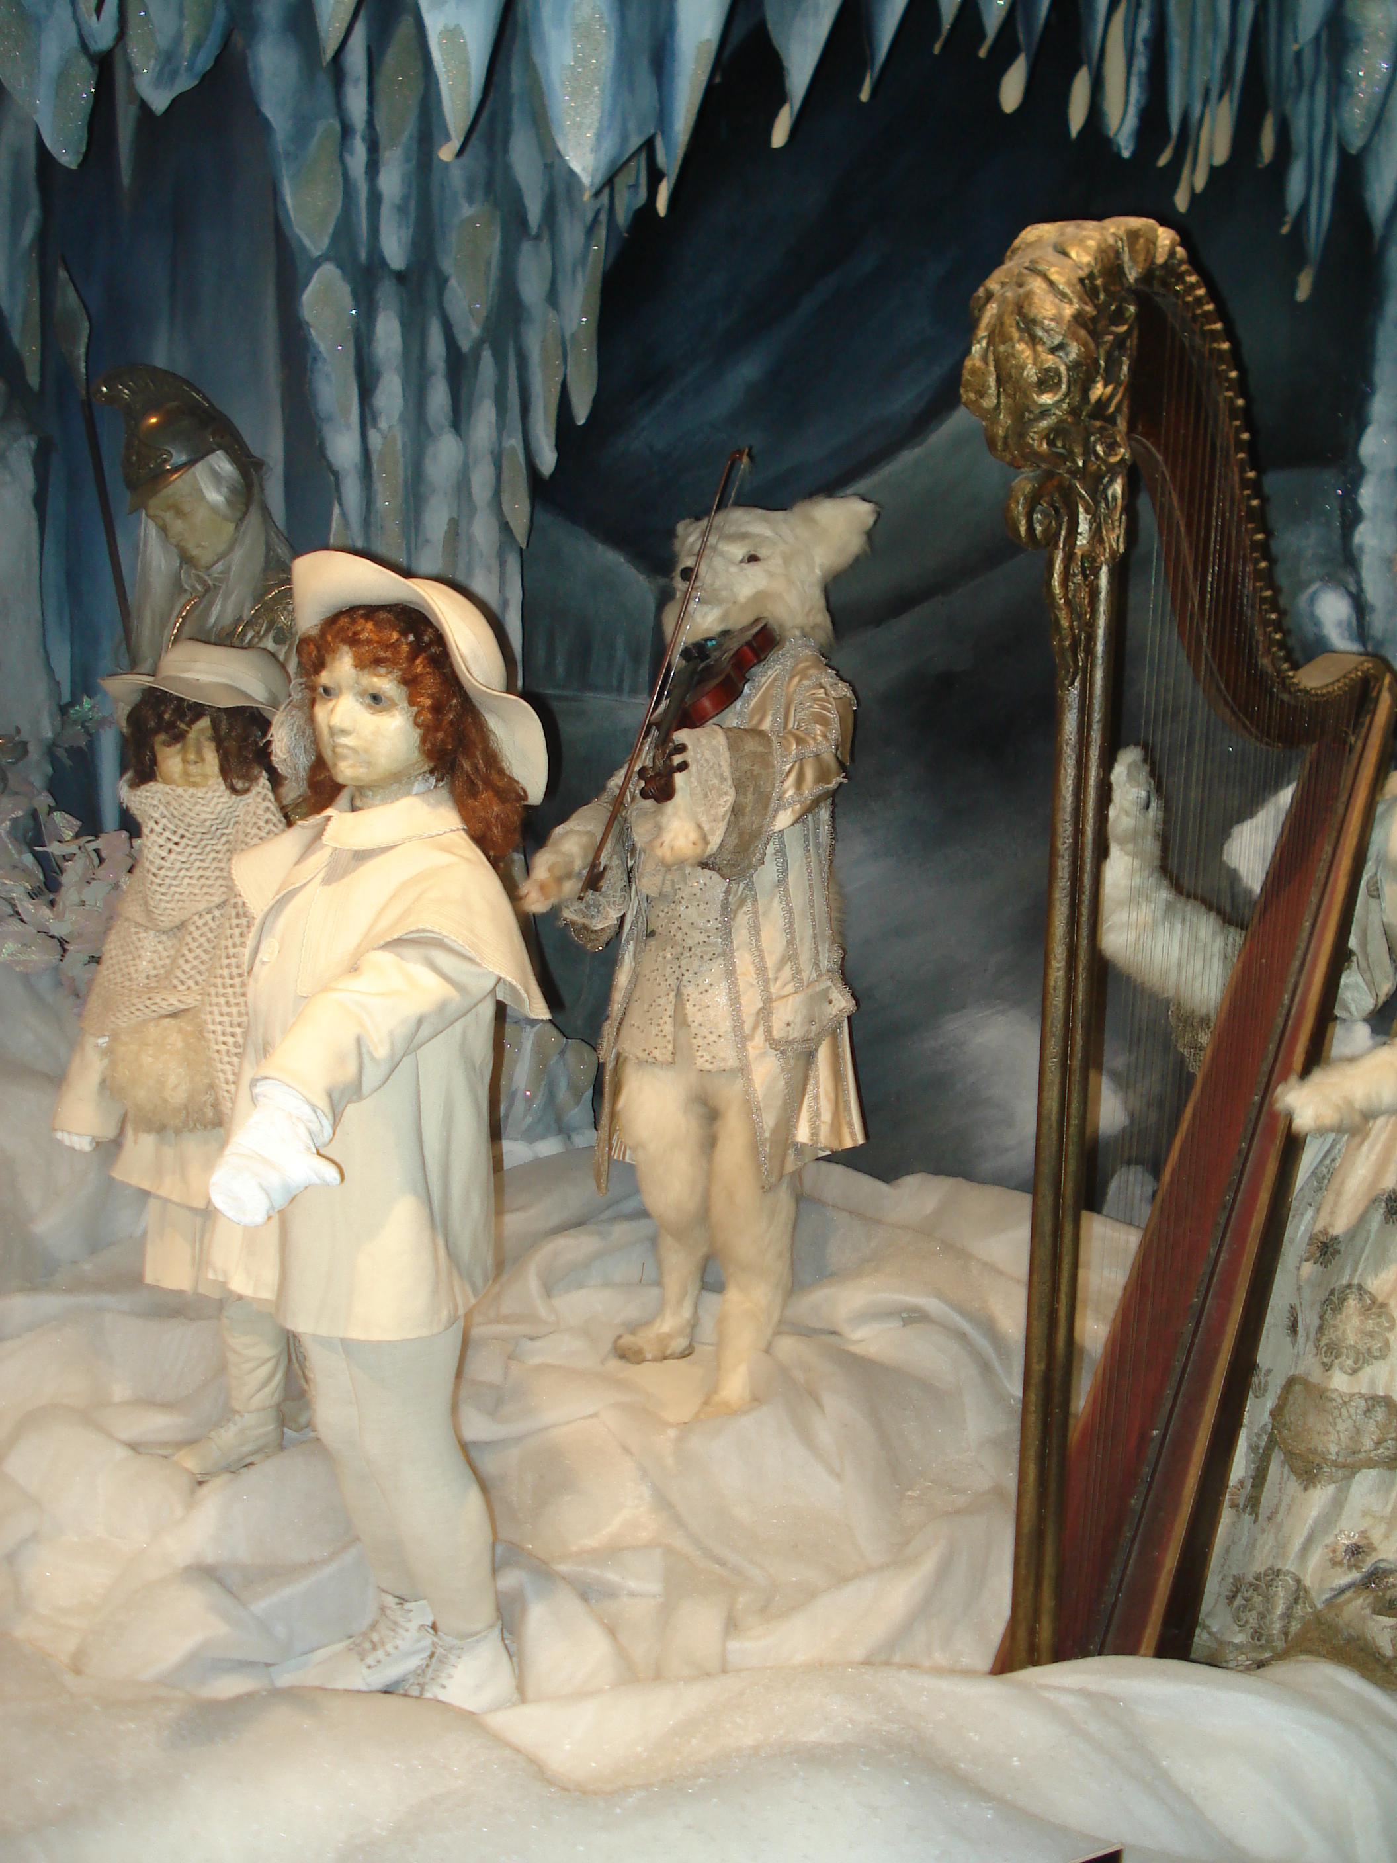
From Automaton…
Descamps, XIXème et XXème siècles
Musée de Souillac

Slide 4
From Automaton…
Toyota, Expo Aichi, Japon 2005

Slide 5
From Automaton…
LAAS-CNRS, Toulouse, Juin 2009

Slide 6
… to Robot
ABB

Slide 7
… to Robot
LAAS-CNRS, JRL

Slide 8
… to Robot
Autonomy components:
Perception (signal processing)
Decision (algorithmics)
Action (control)

Slide 9
Mathematical foundations of
robot motion
Jean-Paul Laumond

Slide 10
30 years of motion planning
A sea of faces
Notes:
So we have seen that the obstacle can be transferred in the configuration. The motion is also well defined is configuration space.
If we look of the motion of this animation. It is set of positions of the system. They corresponds to a continuous curve in the configuration space, on the surface of the tore.

Slide 11
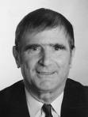
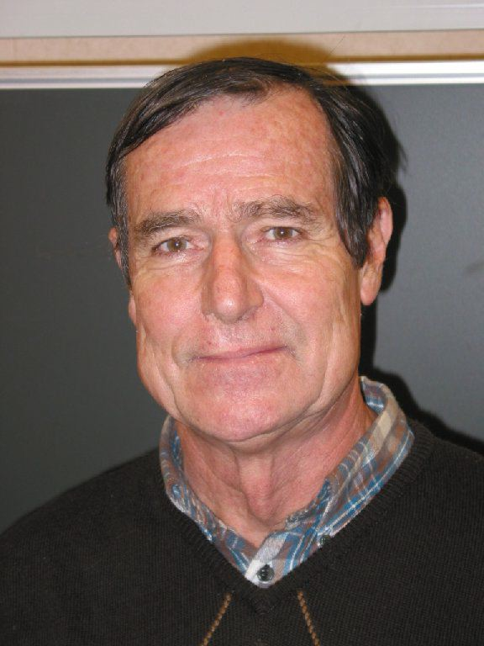
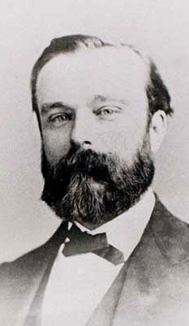
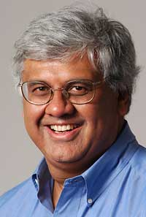
A s e a o f f a c e s

Slide 12
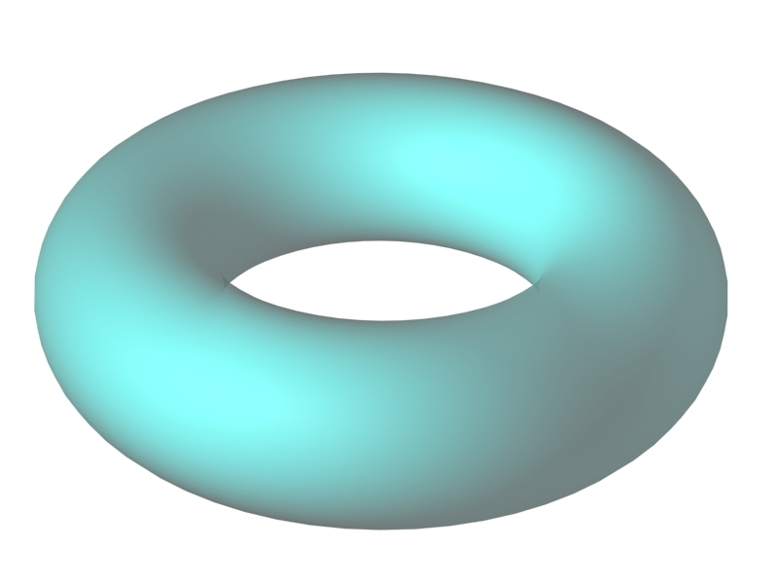
R o b o t M o t i o n P l a n n i n g
Motion : a continuous function from time to space

Slide 13
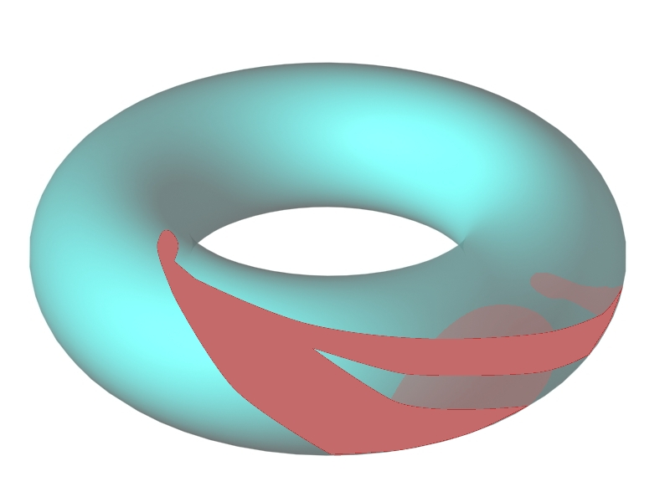
R o b o t M o t i o n P l a n n i n g
Motion : a continuous function from time to space

Slide 14
C o n f i g u r a t i o n S p a c e
Any admissible motion for the 3D mechanical system appears a collision-free path for a point in the CSpace
Notes:
So we have seen that the obstacle can be transferred in the configuration. The motion is also well defined is configuration space.
If we look of the motion of this animation. It is set of positions of the system. They corresponds to a continuous curve in the configuration space, on the surface of the tore.

Slide 15
A l g o r i t h m i c P a t h P l a n n i n g
Translating the continuous problem into a combinatorial one
Capturing the topology of CSfree with graphs
Notes:
So we have seen that the obstacle can be transferred in the configuration. The motion is also well defined is configuration space.
If we look of the motion of this animation. It is set of positions of the system. They corresponds to a continuous curve in the configuration space, on the surface of the tore.

Slide 16
A l g o r i t h m i c P a t h P l a n n i n g
The 80’s
The « piano mover » problem is decidable
Proof: Elementary algebra decidability
Notes:
So we have seen that the obstacle can be transferred in the configuration. The motion is also well defined is configuration space.
If we look of the motion of this animation. It is set of positions of the system. They corresponds to a continuous curve in the configuration space, on the surface of the tore.

Slide 17
A l g o r i t h m i c P a t h P l a n n i n g
The 80’s
The « piano mover » problem is decidable
Doubly exponential constructive proof:
Cylindrical algebraic decomposition
Notes:
So we have seen that the obstacle can be transferred in the configuration. The motion is also well defined is configuration space.
If we look of the motion of this animation. It is set of positions of the system. They corresponds to a continuous curve in the configuration space, on the surface of the tore.

Slide 18
A l g o r i t h m i c P a t h P l a n n i n g
The 80’s
The « piano mover » problem is decidable
Single exponential constructive proof:
Retraction
Notes:
So we have seen that the obstacle can be transferred in the configuration. The motion is also well defined is configuration space.
If we look of the motion of this animation. It is set of positions of the system. They corresponds to a continuous curve in the configuration space, on the surface of the tore.

Slide 19
A l g o r i t h m i c P a t h P l a n n i n g
The 80’s
The « piano mover » problem is decidable
NP-hardness
Notes:
So we have seen that the obstacle can be transferred in the configuration. The motion is also well defined is configuration space.
If we look of the motion of this animation. It is set of positions of the system. They corresponds to a continuous curve in the configuration space, on the surface of the tore.

Slide 20
A l g o r i t h m i c P a t h P l a n n i n g
The 80’s
Existence of motion in contact
Proof: Algebraic topology
Notes:
So we have seen that the obstacle can be transferred in the configuration. The motion is also well defined is configuration space.
If we look of the motion of this animation. It is set of positions of the system. They corresponds to a continuous curve in the configuration space, on the surface of the tore.

Slide 21
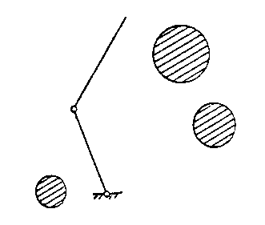
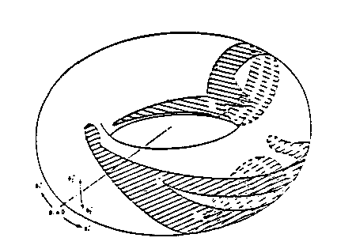
A l g o r i t h m i c P a t h P l a n n i n g
The 80’s
Existence of motion in contact
Proof: Algebraic topology
Notes:
So we have seen that the obstacle can be transferred in the configuration. The motion is also well defined is configuration space.
If we look of the motion of this animation. It is set of positions of the system. They corresponds to a continuous curve in the configuration space, on the surface of the tore.

Slide 22
A l g o r i t h m i c P a t h P l a n n i n g
The 80’s
Existence of motion in contact
Proof: Algebraic topology
Notes:
So we have seen that the obstacle can be transferred in the configuration. The motion is also well defined is configuration space.
If we look of the motion of this animation. It is set of positions of the system. They corresponds to a continuous curve in the configuration space, on the surface of the tore.

Slide 23
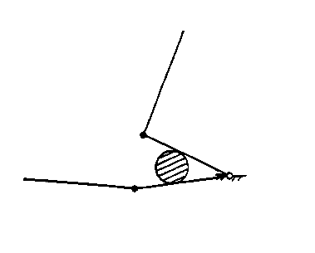
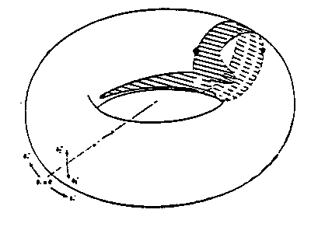
A l g o r i t h m i c P a t h P l a n n i n g
The 80’s
Existence of motion in contact
Proof: Algebraic topology
Notes:
So we have seen that the obstacle can be transferred in the configuration. The motion is also well defined is configuration space.
If we look of the motion of this animation. It is set of positions of the system. They corresponds to a continuous curve in the configuration space, on the surface of the tore.

Slide 24
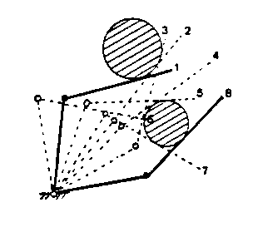
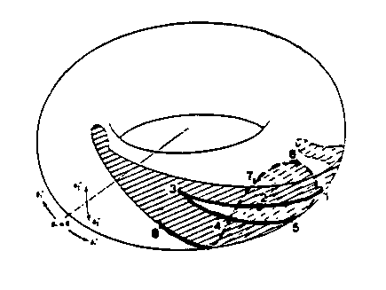
A l g o r i t h m i c P a t h P l a n n i n g
The 80’s
Existence of motion in contact
Proof: Algebraic topology
Notes:
So we have seen that the obstacle can be transferred in the configuration. The motion is also well defined is configuration space.
If we look of the motion of this animation. It is set of positions of the system. They corresponds to a continuous curve in the configuration space, on the surface of the tore.

Slide 25
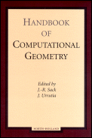
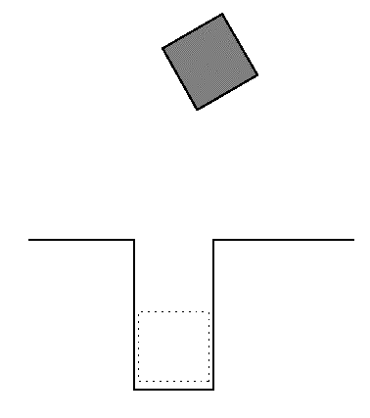
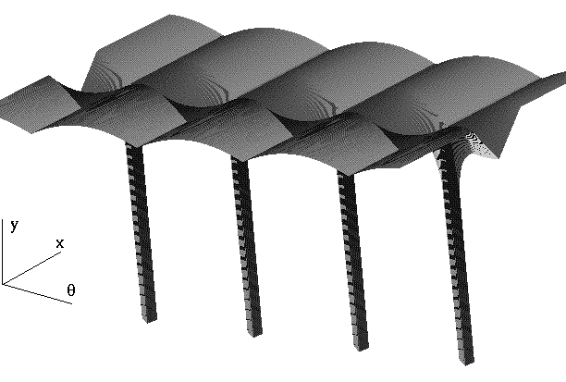
A l g o r i t h m i c P a t h P l a n n i n g
The 80’s
Special cases and computational geometry
Notes:
So we have seen that the obstacle can be transferred in the configuration. The motion is also well defined is configuration space.
If we look of the motion of this animation. It is set of positions of the system. They corresponds to a continuous curve in the configuration space, on the surface of the tore.

Slide 26
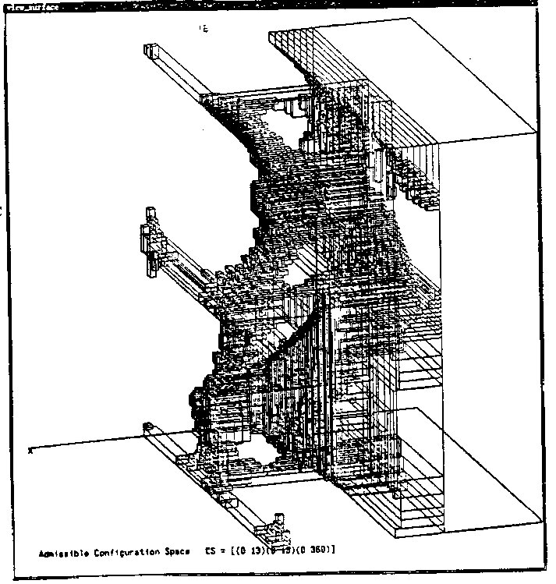
A l g o r i t h m i c P a t h P l a n n i n g
The 80’s: and then?
No hope for efficient exact and complete solution
Approximated solution
Notes:
So we have seen that the obstacle can be transferred in the configuration. The motion is also well defined is configuration space.
If we look of the motion of this animation. It is set of positions of the system. They corresponds to a continuous curve in the configuration space, on the surface of the tore.

Slide 27
A l g o r i t h m i c P a t h P l a n n i n g
The 80’s: and then?
No hope for efficient exact and complete solution
Potential fields and optimization methods
Notes:
So we have seen that the obstacle can be transferred in the configuration. The motion is also well defined is configuration space.
If we look of the motion of this animation. It is set of positions of the system. They corresponds to a continuous curve in the configuration space, on the surface of the tore.

Slide 28
When hardware renewed the topic…
Notes:
So we have seen that the obstacle can be transferred in the configuration. The motion is also well defined is configuration space.
If we look of the motion of this animation. It is set of positions of the system. They corresponds to a continuous curve in the configuration space, on the surface of the tore.

Slide 29
R a n d o m S e a r c h e s
The 90’s: the amazing efficiency of empirism!
Notes:
So we have seen that the obstacle can be transferred in the configuration. The motion is also well defined is configuration space.
If we look of the motion of this animation. It is set of positions of the system. They corresponds to a continuous curve in the configuration space, on the surface of the tore.

Slide 30
R a n d o m S e a r c h e s
The 90’s: the amazing efficiency of empirism!
Random sampling
Notes:
So we have seen that the obstacle can be transferred in the configuration. The motion is also well defined is configuration space.
If we look of the motion of this animation. It is set of positions of the system. They corresponds to a continuous curve in the configuration space, on the surface of the tore.

Slide 31
R a n d o m S e a r c h e s
The 90’s: the amazing efficiency of empirism!
Random diffusion
Notes:
So we have seen that the obstacle can be transferred in the configuration. The motion is also well defined is configuration space.
If we look of the motion of this animation. It is set of positions of the system. They corresponds to a continuous curve in the configuration space, on the surface of the tore.

Slide 32
R a n d o m S e a r c h e s
The 90’s: the amazing efficiency of empirism!
Notes:
So we have seen that the obstacle can be transferred in the configuration. The motion is also well defined is configuration space.
If we look of the motion of this animation. It is set of positions of the system. They corresponds to a continuous curve in the configuration space, on the surface of the tore.

Slide 33
R o b o t M o t i o n P l a n n i n g
…and that works!

Slide 34
R o b o t M o t i o n P l a n n i n g
Pause

Slide 35
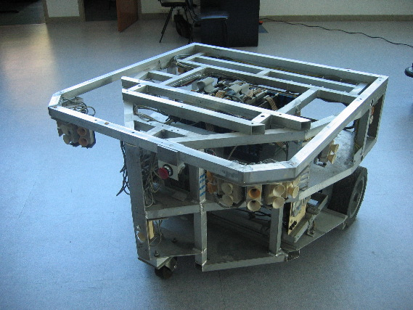
N o n h o l o n o m i c s y s t e m s
Notes:
So we have seen that the obstacle can be transferred in the configuration. The motion is also well defined is configuration space.
If we look of the motion of this animation. It is set of positions of the system. They corresponds to a continuous curve in the configuration space, on the surface of the tore.

Slide 36
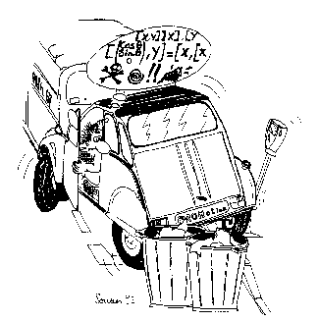
N o n h o l o n o m i c s y s t e m s
The 90’s: rolling without sliding!
Notes:
So we have seen that the obstacle can be transferred in the configuration. The motion is also well defined is configuration space.
If we look of the motion of this animation. It is set of positions of the system. They corresponds to a continuous curve in the configuration space, on the surface of the tore.

Slide 37
N o n h o l o n o m i c s y s t e m s
The 90’s
Any admissible motion for the 3D mechanical system appears a collision-free path for a point in the Cspace
Holonomic systems: converse is true
Nonholonomic ones: converse is not true
Notes:
So we have seen that the obstacle can be transferred in the configuration. The motion is also well defined is configuration space.
If we look of the motion of this animation. It is set of positions of the system. They corresponds to a continuous curve in the configuration space, on the surface of the tore.

Slide 38
N o n h o l o n o m i c s y s t e m s
The 90’s: the car-like robot
The number of maneuvers varies as the inverse of the square of the size of the free-space
Notes:
So we have seen that the obstacle can be transferred in the configuration. The motion is also well defined is configuration space.
If we look of the motion of this animation. It is set of positions of the system. They corresponds to a continuous curve in the configuration space, on the surface of the tore.

Slide 39
N o n h o l o n o m i c s y s t e m s
Holonomy versus nonholonomy: an integrability question
Notes:
So we have seen that the obstacle can be transferred in the configuration. The motion is also well defined is configuration space.
If we look of the motion of this animation. It is set of positions of the system. They corresponds to a continuous curve in the configuration space, on the surface of the tore.

Slide 40
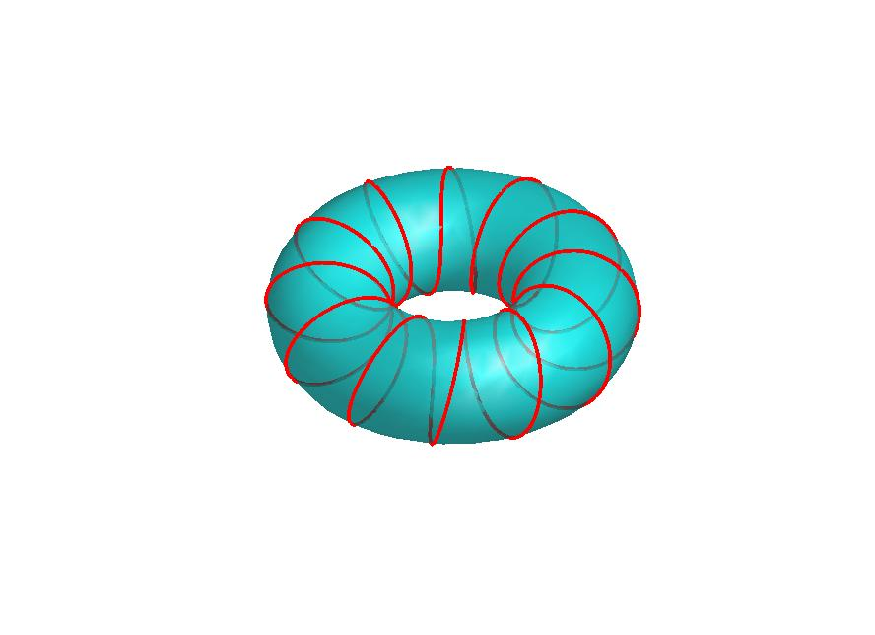
N o n h o l o n o m i c s y s t e m s
Holonomy versus nonholonomy: an integrability question
Not integrable
Dim(Reachable(q))=3
The time that will
never happen!!!
Notes:
So we have seen that the obstacle can be transferred in the configuration. The motion is also well defined is configuration space.
If we look of the motion of this animation. It is set of positions of the system. They corresponds to a continuous curve in the configuration space, on the surface of the tore.

Slide 41
N o n h o l o n o m i c s y s t e m s
Small-time controllability
Notes:
So we have seen that the obstacle can be transferred in the configuration. The motion is also well defined is configuration space.
If we look of the motion of this animation. It is set of positions of the system. They corresponds to a continuous curve in the configuration space, on the surface of the tore.

Slide 42
N o n h o l o n o m i c s y s t e m s
Small-time controllability
Notes:
So we have seen that the obstacle can be transferred in the configuration. The motion is also well defined is configuration space.
If we look of the motion of this animation. It is set of positions of the system. They corresponds to a continuous curve in the configuration space, on the surface of the tore.

Slide 43
N o n h o l o n o m i c s y s t e m s
Small-time controllability
Notes:
So we have seen that the obstacle can be transferred in the configuration. The motion is also well defined is configuration space.
If we look of the motion of this animation. It is set of positions of the system. They corresponds to a continuous curve in the configuration space, on the surface of the tore.

Slide 44
N o n h o l o n o m i c s y s t e m s
Small-time controllability
Notes:
So we have seen that the obstacle can be transferred in the configuration. The motion is also well defined is configuration space.
If we look of the motion of this animation. It is set of positions of the system. They corresponds to a continuous curve in the configuration space, on the surface of the tore.

Slide 45
N o n h o l o n o m i c s y s t e m s
Small-time controllability
For small-time controllable systems the existence of an admissible motion is characterized by the existence of a path lying in an open connected component of free-CSpace
Notes:
So we have seen that the obstacle can be transferred in the configuration. The motion is also well defined is configuration space.
If we look of the motion of this animation. It is set of positions of the system. They corresponds to a continuous curve in the configuration space, on the surface of the tore.

Slide 46
N o n h o l o n o m i c s y s t e m s
Two central questions
Is my system nonholonomic ?
Is my nonholonomic system small-time controllable ?
Notes:
So we have seen that the obstacle can be transferred in the configuration. The motion is also well defined is configuration space.
If we look of the motion of this animation. It is set of positions of the system. They corresponds to a continuous curve in the configuration space, on the surface of the tore.

Slide 47
N o n h o l o n o m i c s y s t e m s
Two central questions
Is my system nonholonomic ?
Frobenius Theorem
Is my nonholonomic system small-time controllable ?
Lie Algebra Rank Condition
Notes:
So we have seen that the obstacle can be transferred in the configuration. The motion is also well defined is configuration space.
If we look of the motion of this animation. It is set of positions of the system. They corresponds to a continuous curve in the configuration space, on the surface of the tore.

Slide 48
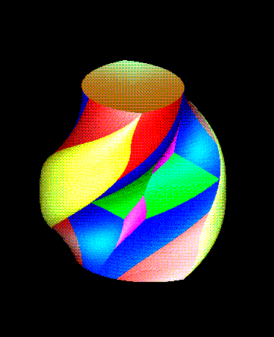
N o n h o l o n o m i c s y s t e m s
Devising steering methods that account for small-time controllability
Optimal control
Notes:
So we have seen that the obstacle can be transferred in the configuration. The motion is also well defined is configuration space.
If we look of the motion of this animation. It is set of positions of the system. They corresponds to a continuous curve in the configuration space, on the surface of the tore.

Slide 49
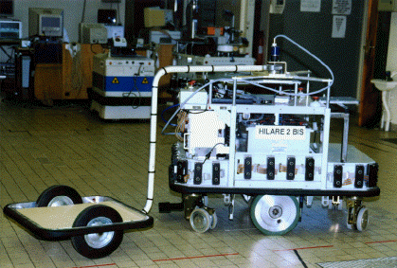
N o n h o l o n o m i c s y s t e m s
Devising steering methods that account for small-time controllability
Optimal control: numerical approach
Notes:
So we have seen that the obstacle can be transferred in the configuration. The motion is also well defined is configuration space.
If we look of the motion of this animation. It is set of positions of the system. They corresponds to a continuous curve in the configuration space, on the surface of the tore.

Slide 50
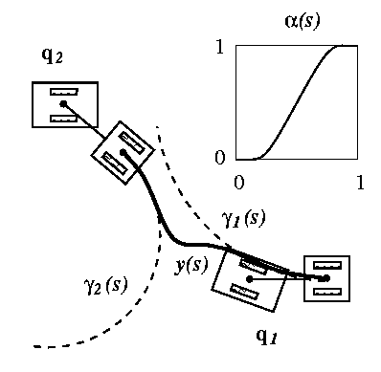
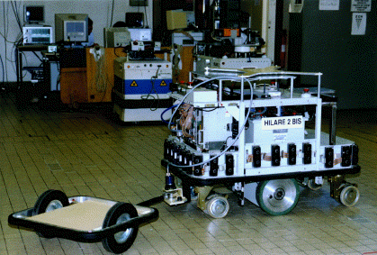
N o n h o l o n o m i c s y s t e m s
Devising steering methods that account for small-time controllability
Chained-from systems
Flatness
Notes:
So we have seen that the obstacle can be transferred in the configuration. The motion is also well defined is configuration space.
If we look of the motion of this animation. It is set of positions of the system. They corresponds to a continuous curve in the configuration space, on the surface of the tore.

Slide 51
N o n h o l o n o m i c s y s t e m s
Nonholonomic metrics as a model of computational complexity
Notes:
So we have seen that the obstacle can be transferred in the configuration. The motion is also well defined is configuration space.
If we look of the motion of this animation. It is set of positions of the system. They corresponds to a continuous curve in the configuration space, on the surface of the tore.

Slide 52
N o n h o l o n o m i c s y s t e m s
Remaining open problems
clothoids
involutes of a circle
Time-optimal control
Notes:
So we have seen that the obstacle can be transferred in the configuration. The motion is also well defined is configuration space.
If we look of the motion of this animation. It is set of positions of the system. They corresponds to a continuous curve in the configuration space, on the surface of the tore.

Slide 53
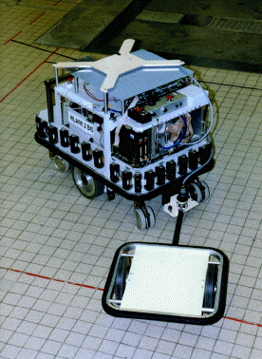
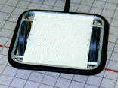
N o n h o l o n o m i c s y s t e m s
Remaining open problems
Hooking
centered
not
2
2
3
3
4
5
5
(2,3,4,5) versus (2,3,5)
Notes:
So we have seen that the obstacle can be transferred in the configuration. The motion is also well defined is configuration space.
If we look of the motion of this animation. It is set of positions of the system. They corresponds to a continuous curve in the configuration space, on the surface of the tore.

Slide 54
N o n h o l o n o m i c s y s t e m s
Remaining open problems
Not small-time controllable systems:
is the problem still decidable?
Notes:
So we have seen that the obstacle can be transferred in the configuration. The motion is also well defined is configuration space.
If we look of the motion of this animation. It is set of positions of the system. They corresponds to a continuous curve in the configuration space, on the surface of the tore.

Slide 55
R o b o t M o t i o n P l a n n i n g
…and that works!

Slide 56
R o b o t M o t i o n P l a n n i n g
Robot motion autonomy

Slide 57
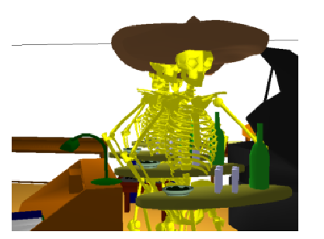
B e y o n d R o b o t i c s
Computer animation

Slide 58
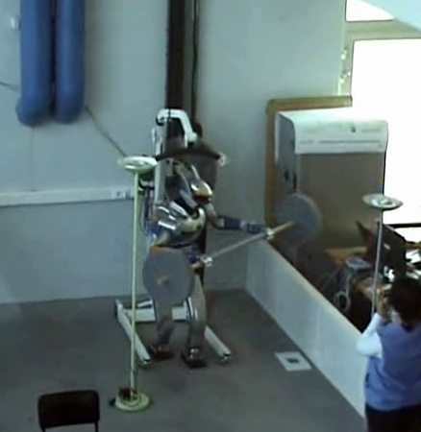
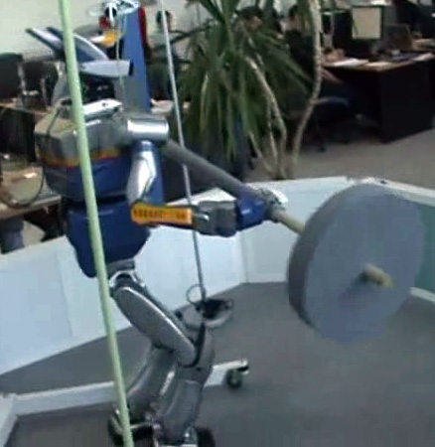
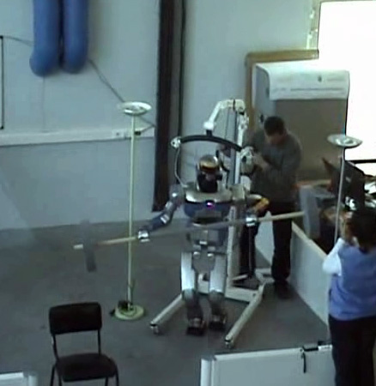
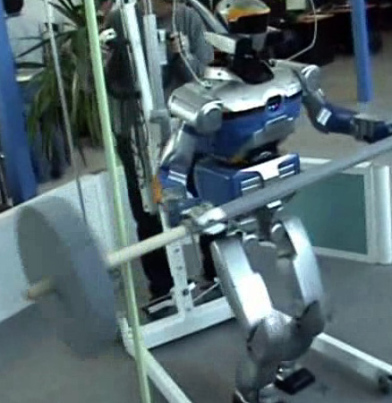
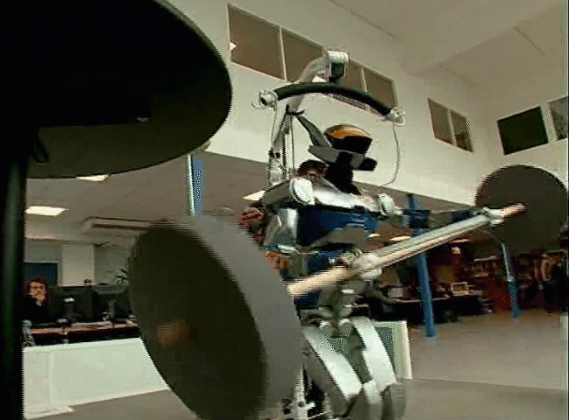
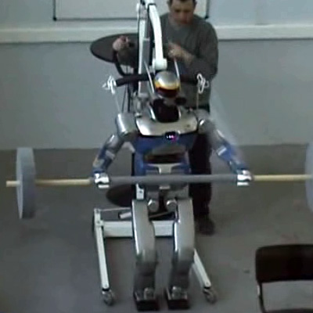
R o b o t i c s
Humanoid robots

Slide 59
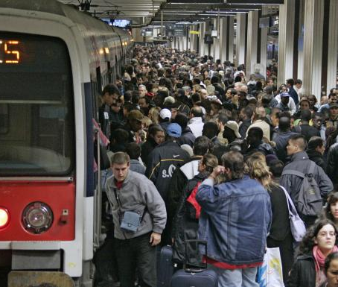
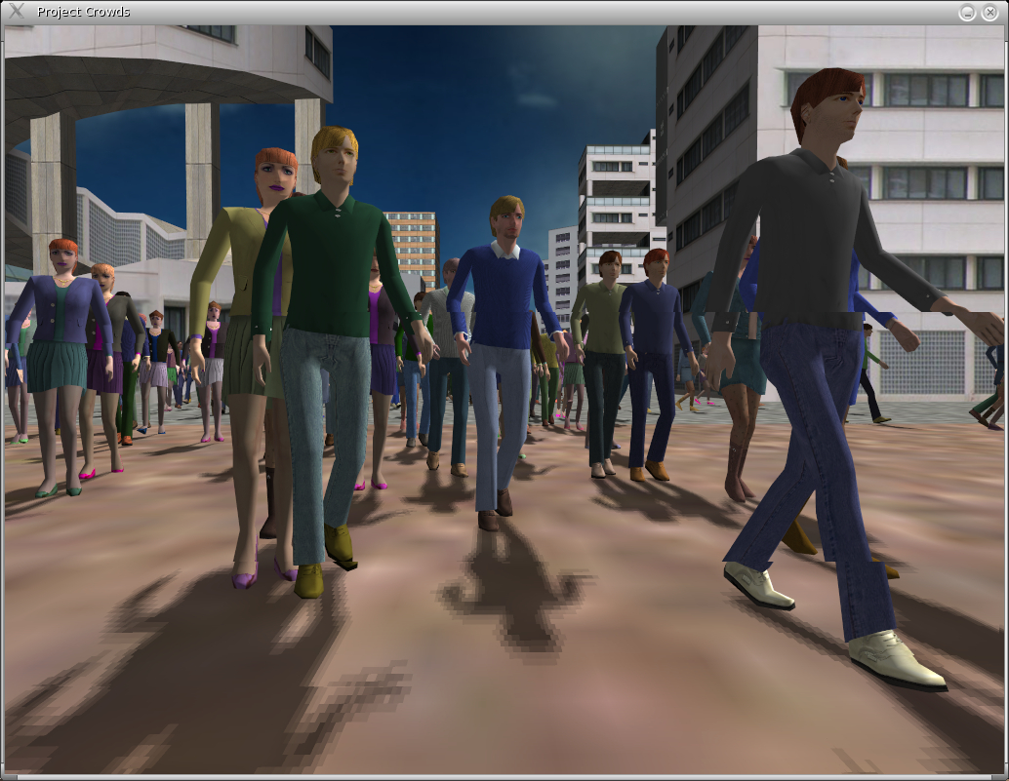
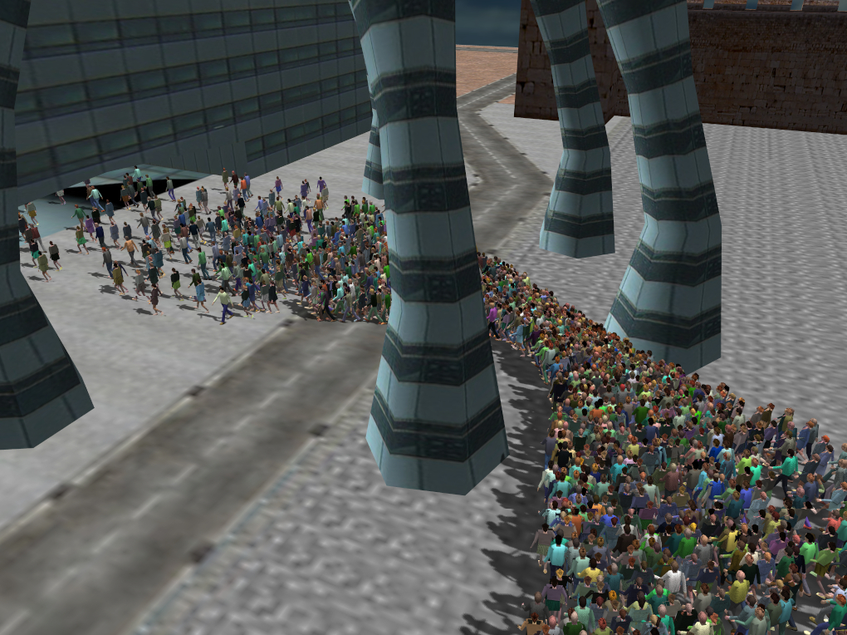
B e y o n d R o b o t i c s
Computer animation

Slide 60
R o b o t M o t i o n P l a n n i n g
Robot programming

Slide 61
B e y o n d R o b o t i c s
Product Lifecycle Management
Automotive industry

Slide 62
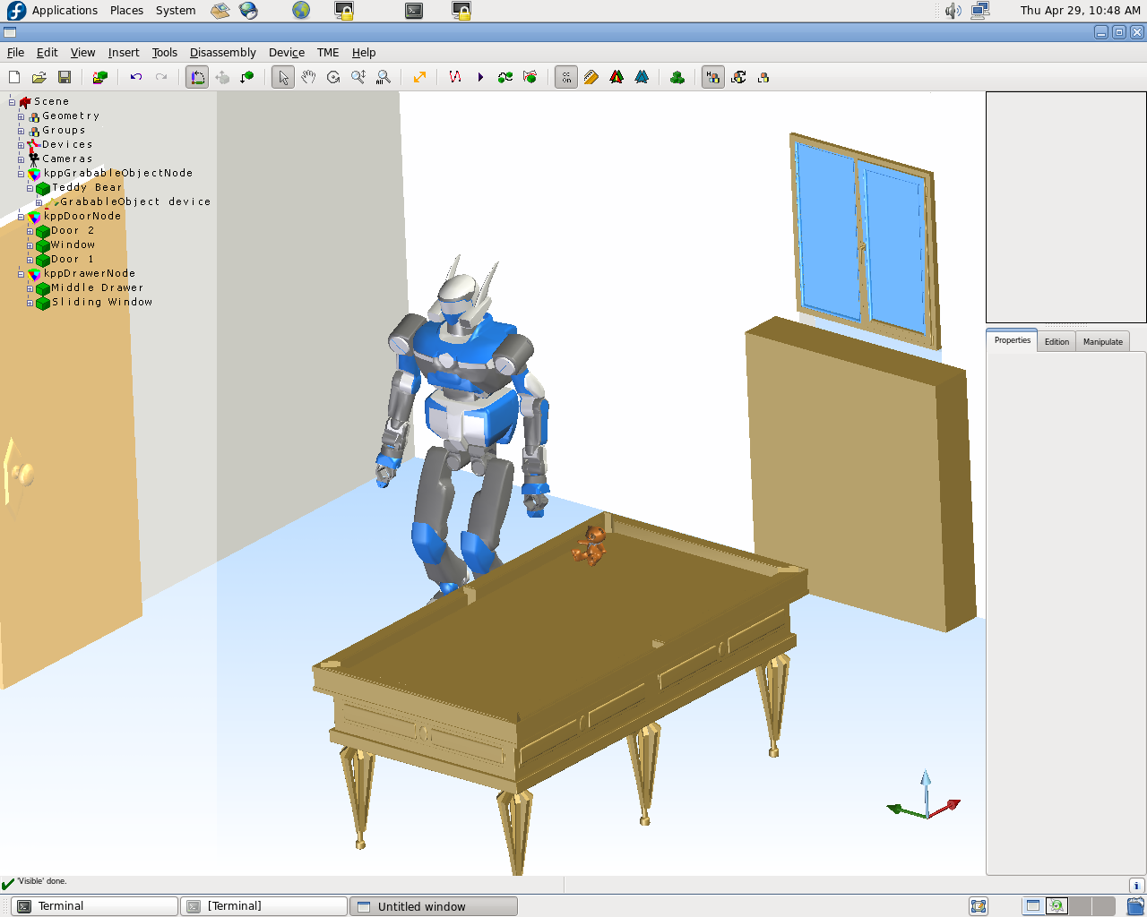
R o b o t M o t i o n P l a n n i n g
Academic software version
www.kineocam.com

Slide 63
B e y o n d R o b o t i c s
Molecular modeling

Slide 64
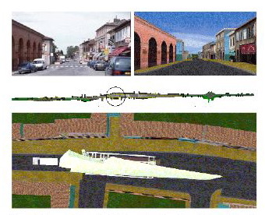
B e y o n d R o b o t i c s
A380 component transportation by road
They were right !!...

Slide 65
B e y o n d R o b o t i c s
Life Sciences

Slide 66
B e y o n d R o b o t i c s
Life Sciences

Slide 67
R o b o t M o t i o n P l a n n i n g
As a conclusion…
« Doing while understanding »

