Slide 1
Elective in Software and Services
(Complementi di software e servizi per la società dell'informazione)
Section Information Visualization
Number of credits : 3
Tutor: Marco Angelini (angelini@dis.uniroma1.it)
Final Assignment
A.A. 2013/14

Slide 2
1.Individual Project
Requirements:
DataSet of your choice (not trivial….)
At least 2 interactive and coordinated Visualizations
4/5 pages elaborate that describes the problem, the design phase and the insights that can be gathered, on the dataset, from the use of the application.
The code must be inserted into the elaborate as an appendix.
An e-mail with:
A brief abstract of the project
The dataSet chosen
must be sent to Professor (in CC: angelini@dis.uniroma1.it) for project approval.
A.A. 2013/14

Slide 3
Group Project
Requirements:
Group composed of a maximum of 3 persons
DataSet chosen/assigned by us (more in the next slides)
Elaborate that describes the problem, the design phase and the insights that can be gathered, on the dataset, from the use of the application. Good explanation of the contribution to the from each member of the group
The code must be inserted into the elaborate as an appendix.
An e-mail with:
Names of the members of the group
A brief abstract of the project
The dataSet chosen
must be sent to Professor (in CC: angelini@dis.uniroma1.it) for project approval.
A.A. 2013/14

Slide 4
Group Project
DataSets:
Data from ISTAT:
Many different datasets available form a main data-warehouse
Money prize for submissions of work until 31/7/2014
http://dati-censimentoindustriaeservizi.istat.it/
Italian Governement Open Data
http://www.dati.gov.it/catalog/dataset
Top World Universities Rankings:
http://www.topuniversities.com/university-rankings
A.A. 2013/14

Slide 5
Group Project
DataSets:
IEEE VAST-Challenge (Conference on Visual Analytics Science and Technology)
3 different mini-challenge, application for 1 of them
An e-mail address is required for downloading the dataset
Possibility for a publication in the proceedings if submitted before
http://vacommunity.org/VAST+Challenge+2014
Users Ratings on Movies:
Also IMDB can be a good resources for well-known ones.
http://grouplens.org/datasets/movielens/
A.A. 2013/14

Slide 6
Submission content
For ALL cases, the submission must contain:
Name and ID of all participants
Source files and Distributable version of the project (they are the same for Local distribution)
Written Relation about design choices , description of works, insights gained, with references to the theoretichal topics (Representation, Presentation,…). In the appendix of the Relation must be present the source code of the visualizations (in D3)
A.A. 2013/14

Slide 7
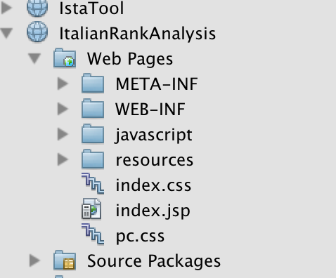
Distribution:LOCAL
For LOCAL data (project self-contained, all the resources are Local):
Extract from the project folder all the resources (html, javascript ,css, data files) maintaining the same internal structure as in the project
Put all in a new folder and change the extension of the jsp file in html
This method works ONLY for FIREFOX Browser!!
Project view
Project folder/web/ view
Files/Folder to Extract
A.A. 2013/14

Slide 8
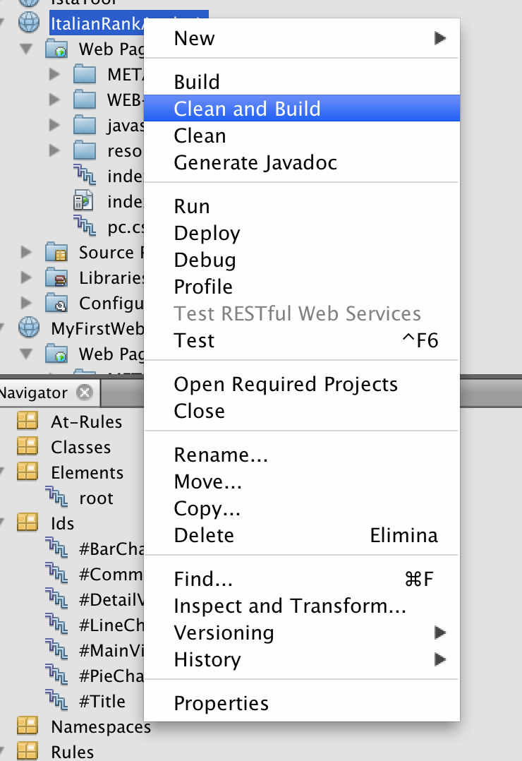
Distribution:WAR
For applications that make use of online resources (data, external tools, etc..)
A new folder (dist) will be created in the main folder of the project, containing the redistributable file (<projectName>.war. This file is ready to be deployed on an Application server.
From the project view, right click on the project name anc choose “Clean and Build” (or “create WAR” in Eclipse)
A.A. 2013/14

Slide 9
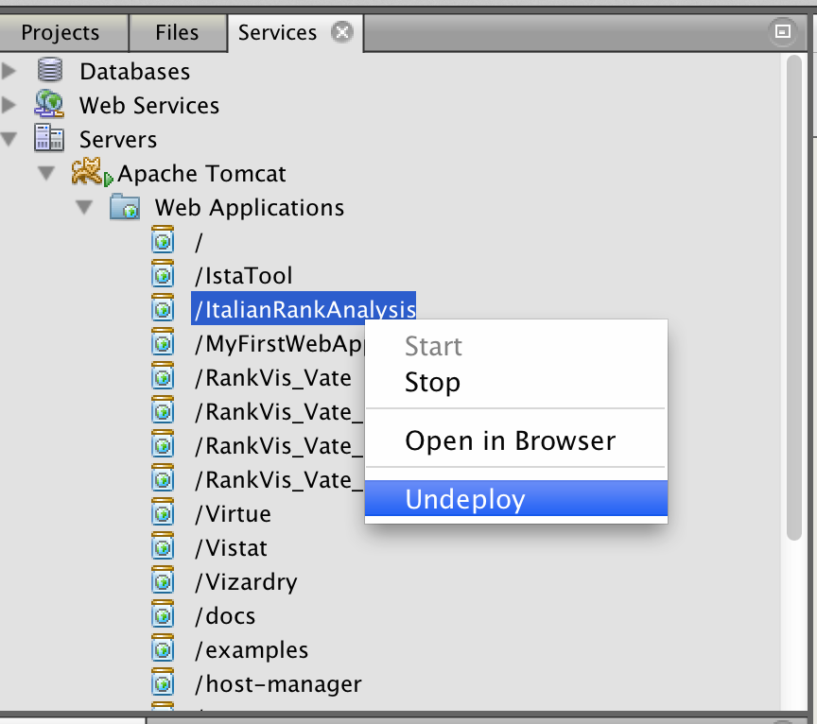
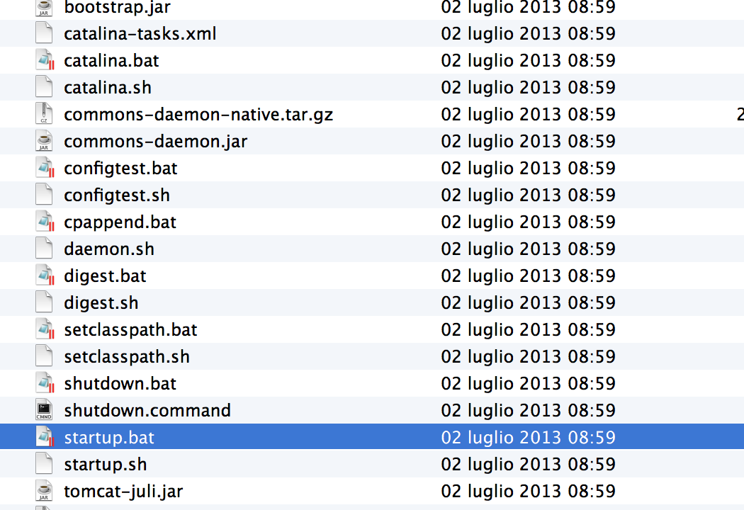
Distribution:WAR
For testing the correct behaviour of the just created war:
Undeploy your application from the server (From server Pane, simply right-click on the name of your application and choose
Then locate the folder in which your server is installed (leave the server running in the ide or launch the “startup.bat” (or similar) file in Tomcat/bin folder)
Go to Tomcat/webapps and copy in this folder the war file. It will auto-extract into the application.
In the submission put Send the war + the source files of the project
A.A. 2013/14

